Slide 1

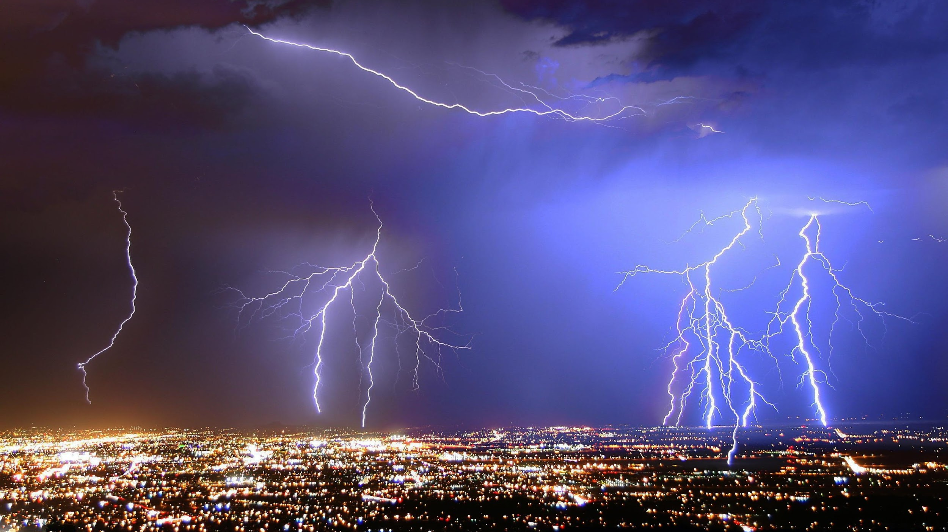
J
A
N
2
0
2
5
ACSE/EDSML MINI-PrOJECT
Predicting the unpredictable
Albuquerque, New Mexico, USA, 2012 (Dave Arnold)

Slide 2

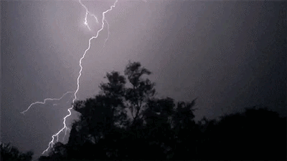
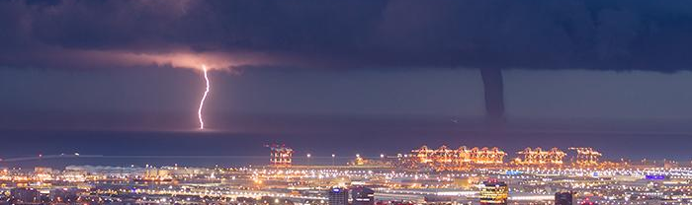
PREDICTING THE UNPREDICTABLE challenge
Mock challenge
We will pretend that the FEMA (Federal Emergency Management Agency) in the US have released an open competition to improve lightning storm prediction.
The call is open to teams of ML specialists (you) that can provide a solution to the problem of forecasting the evolution of lightning storms in real-time.
Each one of the groups will be working on the design and implementation of their solution and present it in a short pitch that will be evaluated by a panel composed by: experts in storm forecasting and budget holders (the money people).
Motivation
Each year, lightning storms cause fatalities, wildfires, power outages, disruptions to air travel and flooding, often with little warning. Approximately 2000 thunderstorms are occurring at any given time around the world¹. Accurate, real-time predictions are essential to protect power grids, guide flight rerouting, and inform evacuation plans. With climate change contributing to more extreme and unpredictable weather patterns, real-time forecasting of lightning storms has never been more crucial: a 1 degree Celsius rise in temperature could result in a 12% increase in lightning strikes².
¹RMetS ²https://doi.org/10.1126/science.1259100

Slide 3
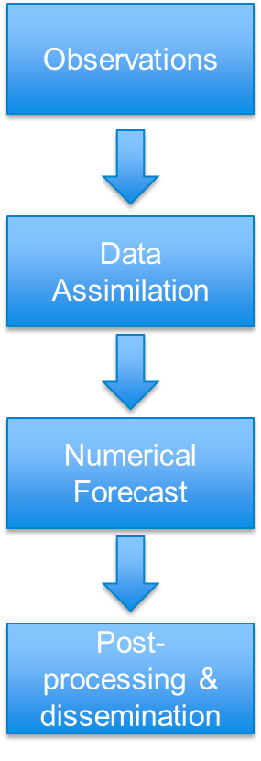
Machine learning in weather forecasting
Weather Forecasting Workflow
Challenges:
Size of the Earth
Chaotic system
Many model components, some processes not well understood
Where does ML fit in? Everywhere!
Observational screening, simple post-processing,
bias correction in data assimilation, emulation of parameterisation schemes,
spatio-temporal downscaling, ..., full replacement of current weather forecasting system [1]
[1] Schultz et al. 2021. Can deep learning beat numerical weather prediction? Phil. Trans. R. Soc. A. 379 https://doi.org/10.1098/rsta.2020.0097.

Slide 4
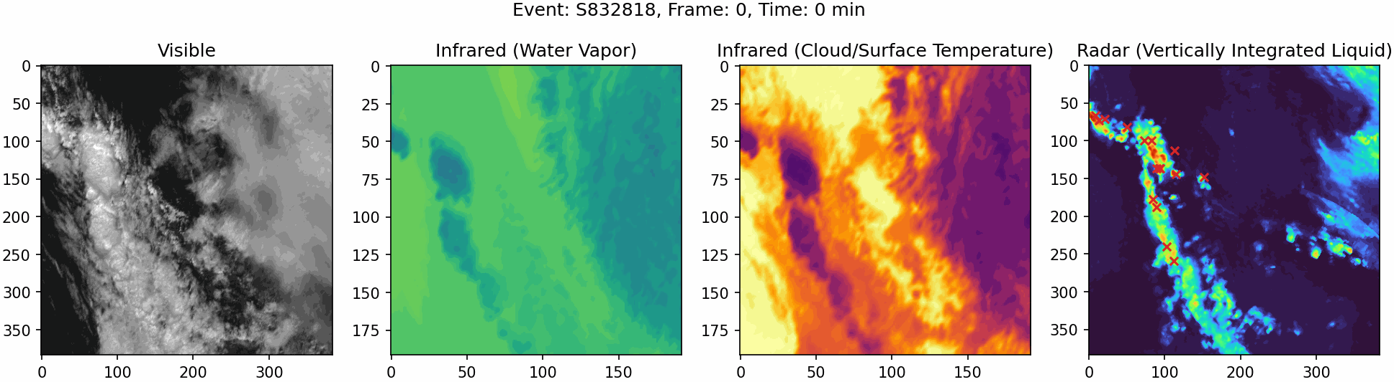
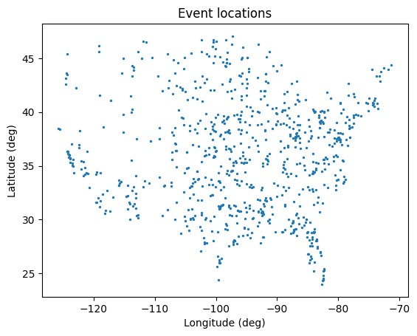
Training Dataset
4 types of satellite images: visible, water vapour (infrared), cloud/surface temperature (infrared), vertically integrated liquid (radar)
Time series of lightning flashes (irregular)
800 example storms over the entire US
Meta data: time, location of images

Slide 5
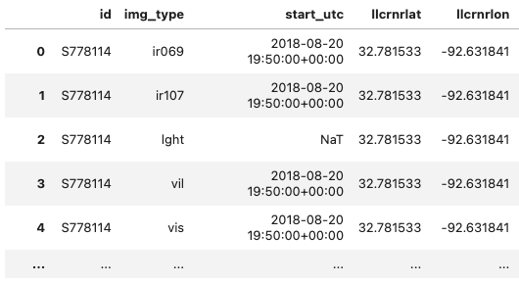
Training Dataset
4 types of satellite images: visible, water vapour (infrared), cloud/surface temperature (infrared), vertically integrated liquid (radar)
Time series of lightning flashes (irregular)
800 example storms over the entire US
Meta data: time, location of images
events.csv

Slide 6
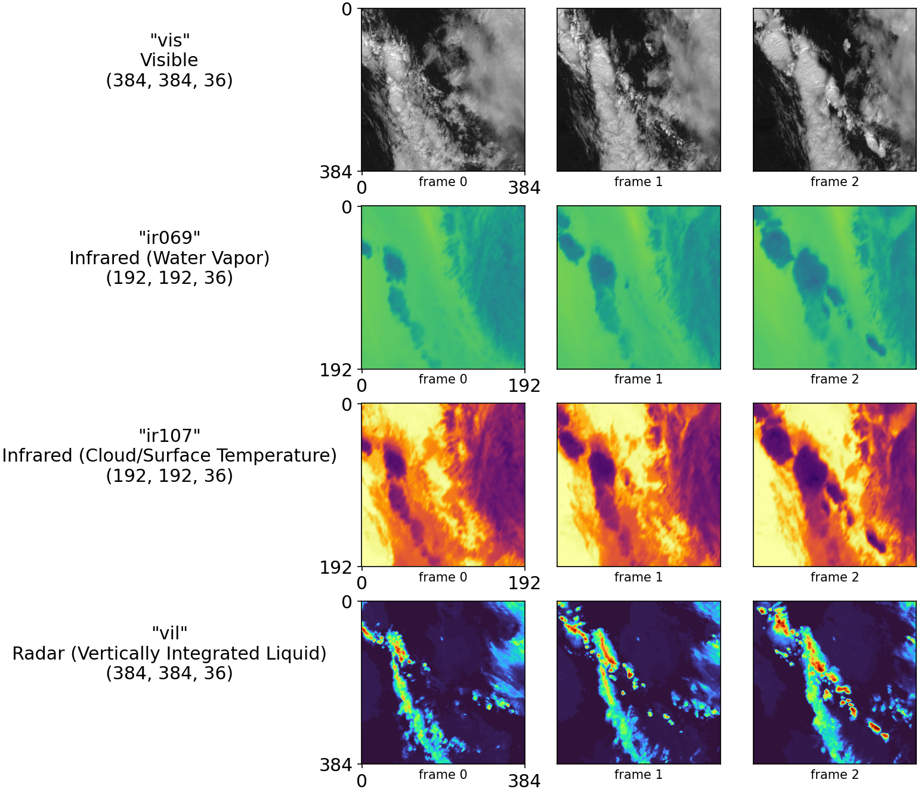
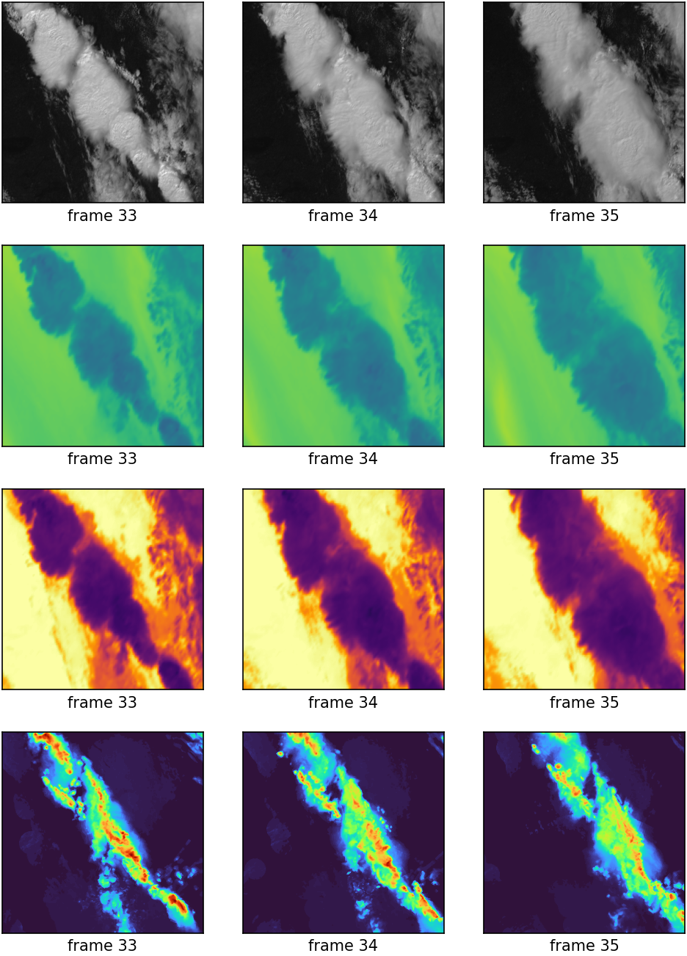
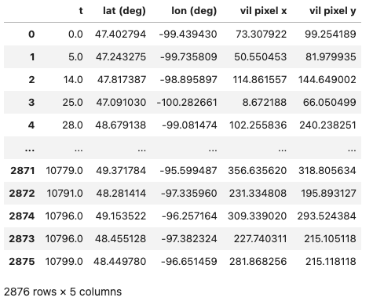
AVAILABLE TRAINING DATA FOR EACH EVENT
…
…
…
“lght”
Lightning time series
(N, 5) array
…
5 mins

Slide 7
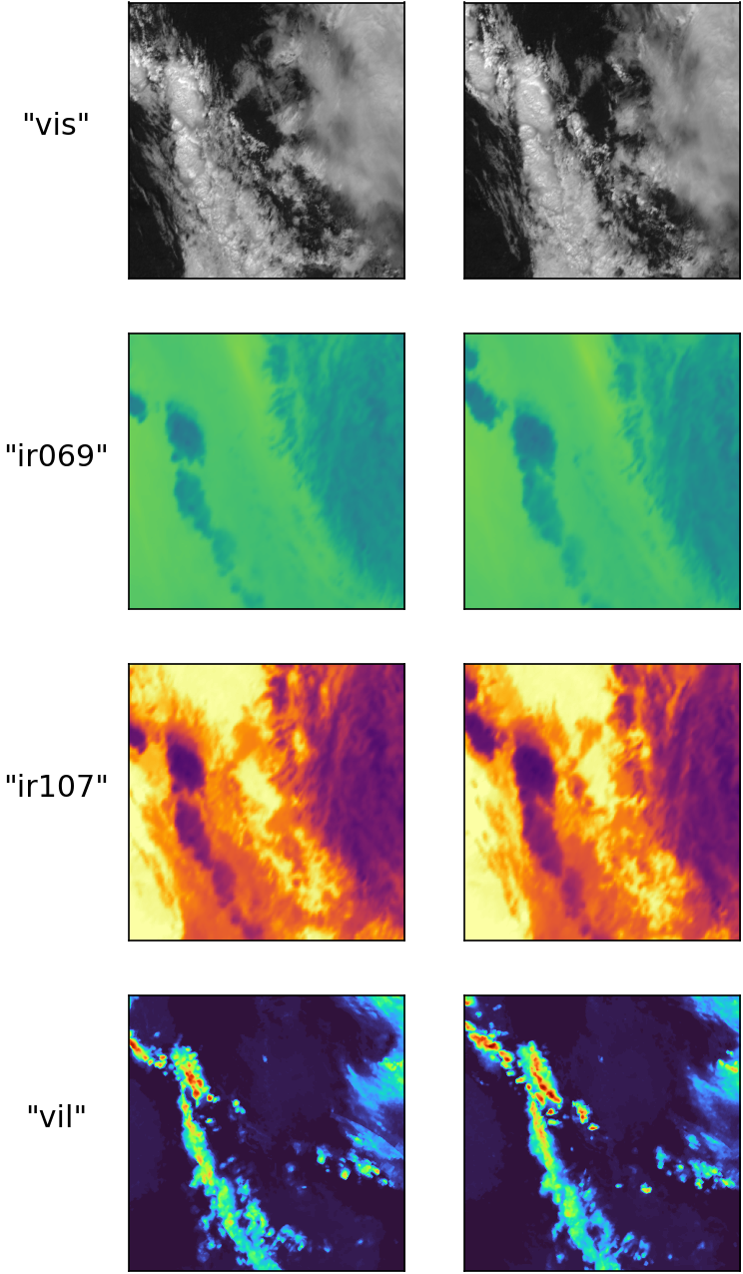
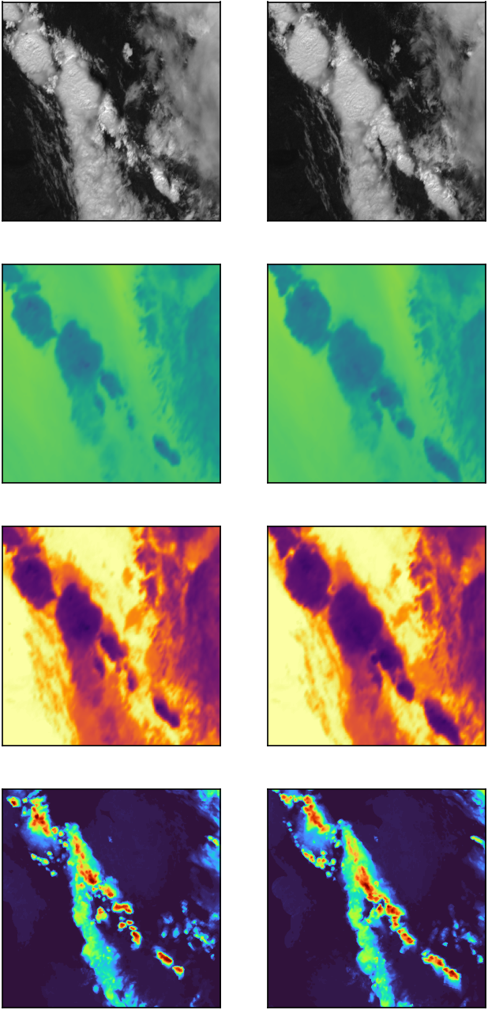
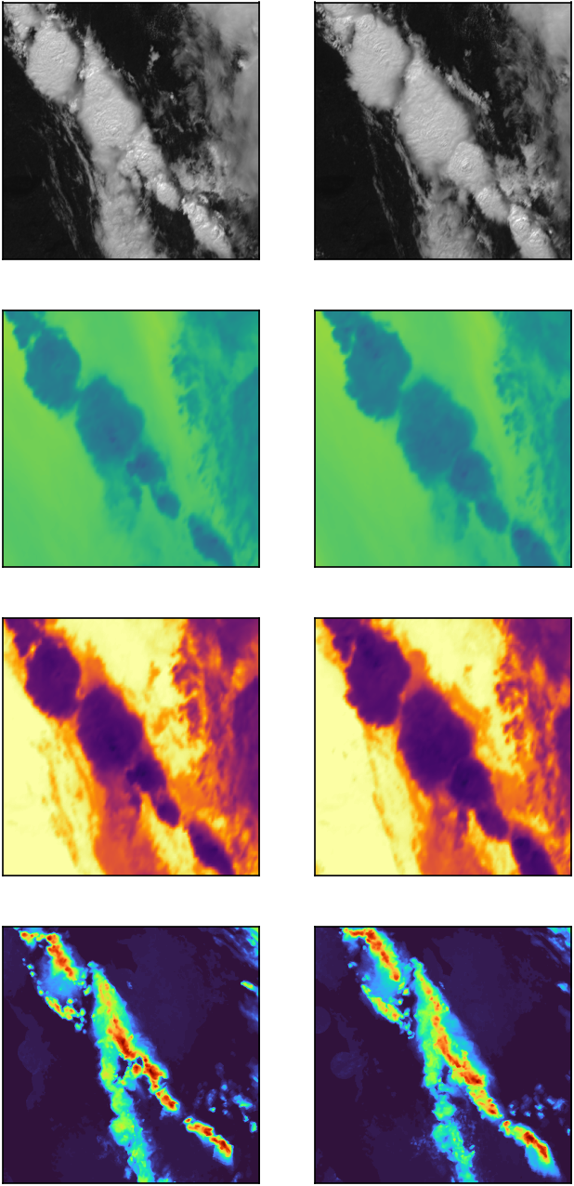
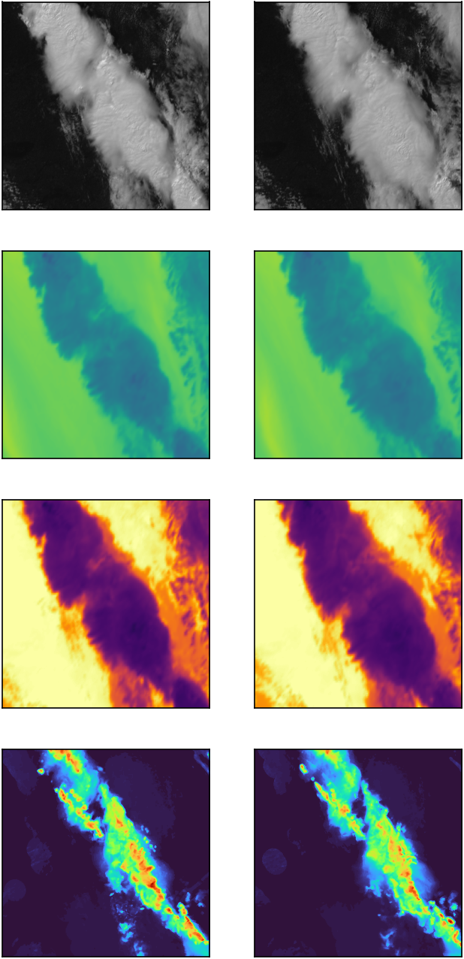
tasks
Task 1a
Your first task will be, given a sequence of 12 “vil” images from a single storm, generate a ML/DL-based solution able to generate 12 future “vil” image predictions based on these input images:
…
…
Frame 1
Frame 12
Frame 13
Frame 24
input data (for one storm)
your predictions

Slide 8
tasks
Task 1B
Given a sequence of 12 “vis”, “ir069”, “ir107”, and “vil” images from a single storm, generate a ML/DL-based solution able to generate 12 future “vil” image predictions based on these input images. Compare your predictions to the predictions from your model from Task 1A.
…
…
…
…
…
Frame 1
Frame 12
Frame 13
Frame 24
input data (for one storm)
your predictions

Slide 9
tasks
Task 2
Your second task will be, given a sequence of “vis”, “ir069”, and “ir107” images from a single storm, generate a ML/DL-based solution able to generate the missing “vil” images based on these input images:
…
input data (for one storm)
…
…
…
your predictions

Slide 10
tasks
Task 3
Your third task will be, given a sequence of “vis”, “ir069”, “ir107”, and “vil” images from a single storm, generate a ML/DL-based solution able to predict the lightning flashes in the sequence. You should predict the number of flashes and the time and “vil” pixel location of each flash.
…
“lght”
Lightning time series
(N, 3) array
…
…
…
input data (for one storm)
your predictions

Slide 11
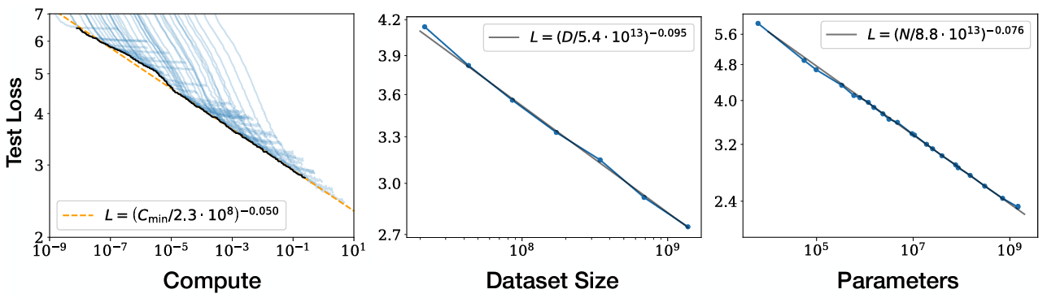
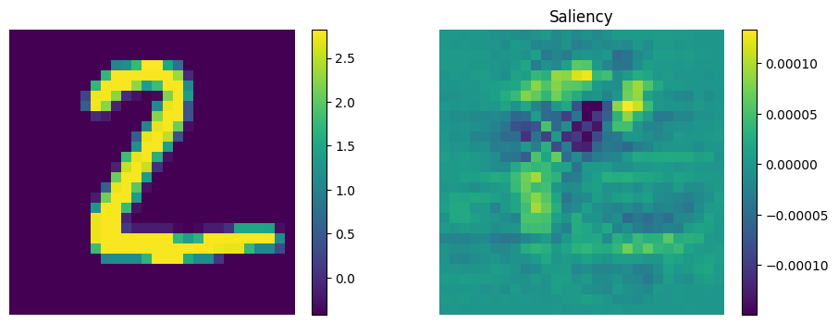
tasks
OPTIONAL BONUS TASKS
We will award bonus points* to teams that assess 1) scaling laws: how does the performance of your models change with compute, dataset size, and model size? 2) explainability: how well can you explain/justify the predictions made by your models?
*You can score full marks without completing the “bonus tasks”, but if you make progress on them, they can improve your score (up to full marks).
Day 4 Intro to CNNs lecture
Kaplan et al, Scaling Laws for Neural Language Models, 2020

Slide 12
Instructions
You are free to use as many training storms as you see fit. You models should be able to generalise over any storm in the training dataset.
There are no restrictions about network architecture, loss function, or any other design decisions.
Your submission will be judged by the panel on your results, in particular, on the justification of the quality of your predicted images and lightning flashes, as well as on a provided test set (surprise storms).
You can score full marks without completing the “bonus tasks”, but if you make progress on them, they can improve your score (up to full marks).

Slide 13

test set: Surprise storms
On Thursday at 12pm we will ask you to evaluate your models on 10 new storms for each task, released then.
By Friday 12pm, you need to provide:
- A Jupyter notebook presenting your results and justifying your predictions on these surprise storms.
- A set of 10 numpy files (.npy) for each task, containing your 10 storm predictions. These files will be used to rank the teams in a competition for the best prediction for each task (using L1 (absolute) error). See our surprise storms notebook for a detailed description of these files and submission instructions.
?

Slide 14
test set: Surprise stormS
For task 1A and 1B, given 12 input frames, you should predict the next 12 “vil” frames on the test set.
For task 2 and 3, you should predict “vil” and “lght” for all the 36 frames provided.
…
…
…
…
…
Frame 1
Frame 12
Frame 13
Frame 24
input data (for one storm)
your predictions

Slide 15
Assessment
Peer evaluation ……………………………………………………………….10 points
Presentation ……………………………………………………………………20 points
Sustainability and packaging ……….……………………………..…20 points
Workflow and design decisions: data inspection, data pre-processing, data split, architectures, learning and evaluation metrics... (shown in notebook) …………………………………………………………………….…………………….25 points
Surprise storm metrics ….………………………………………..………..15 points
Creativity …………………………………………………………………………..10 points
__________________________________________________
Total…………………………………………………………………………………100 points
No requirement to design network from scratch. However it's your responsibility to understand what you find online and to adapt it to this problem. You must explain why you made this decisions (do not forget citations).
Marks will be awarded for more advanced solutions and better performance (Creativity points), but the bulk of marks will be associated with a sustainable and clear workflows that shows well-justified design decisions.
You also be responsible for designing optimisation and evaluation metrics of your network, as well as your data splitting (experimental design).

Slide 16
Deliverables
By Friday 31st January at 12pm:
Github repo, completed and uploaded containing:
One or two notebooks showcasing the design and implementation of the image and lightning flash prediction networks (including any data inspection and treatment). It should include the solutions of the training data throughout development (predicted images and flashes) as well as the metrics you use to evaluate the quality of your results.
One notebook with your workflow applied to the surprise storms, containing your results and justification.
Packaged utility scripts that support the development of your workflow.
Any material produced to address software sustainability. This includes good documentation, any user guidance you decide is appropriate, etc.
Your numpy prediction files for the surprise storms (see submission guide notebook).
By Friday 31st January at 4pm:
15 min presentation to be uploaded to your assigned Teams channel.

Slide 17
Presentation Content
Your presentation is a pitch to the FEMA panel to convince them to acquire the product you have developed.
It should include:
Problem background and motivation.
Description of your solution design: data treatment, model, losses and metrics, workflow, etc.
Main results including training and surprise storm predictions, as well as justification of their quality.
Critical discussion of the challenges of the project, and the advantages and limitations of your solution.
You should upload you presentation to your Teams group channel (pro tip: record a meeting in your Teams group)

Slide 18

Development Platform
One Colab Pro license per person with 100 compute credits will be provided by the college to run your models!
Note: 100 compute credits is roughly 50 T4 GPU hours or 8 A100 GPU hours. Use your credits wisely! We are unable to provide more credits.
You are encouraged to develop packaged scripts from the beginning and use them in your notebook for easier collaboration and co-development.
PRO

Slide 19
Schedule
Monday (27/1) | Tuesday (28/1) | Wednesday (29/1) | Thursday (30/1) | Friday (31/1)
Project introduction (9-11 am) General questions Groups set up and distribution of VCCs to buy Colab compute credits | Work on mini project & Support session (9.30-10.30am) | Work on mini project & Support session (9.30-10.30am) | Work on mini project & Support session (9.30-10.30am) Surprise Storm release (12pm) | Work on mini project & Support session (9.30-10.30am) Submission deadline (code, notebooks & surprise storm predictions) (12pm) Submission deadline (presentation) (4pm) Wrap up session 4pm

Slide 20
Suggested goals for each day
Monday (27/1) | Tuesday (28/1) | Wednesday (29/1) | Thursday (30/1) | Friday (31/1)
Project introduction (9-11 am) Set up Colab, download data, Explore data and tasks | Prototype initial model designs and iterate Develop model performance metrics and visualization | Decide on core models to develop further, improve model design and performance | Final model training Surprise Storm release (12pm) Generate and upload surprise predictions, start preparing notebooks | Finish preparing notebooks, prepare final codebase Submission deadline (code, notebooks & surprise storm predictions) (12pm) Prepare and record presentation Submission deadline (presentation) (4pm) Wrap up session 4pm

Slide 21
Rooms / Support Sessions
Working rooms: RSM 1.51, 1.49
“Breakout” rooms: 1.47, and 3.01 D/E
Rooms for recording presentations on Fri: 3.01 D/E, G32 and the Map room are booked for recording presentations. We also encourage booking spaces in the library, and some office space will be made available.
Support sessions: 1.47, 9:30-10:30am every morning
Each group will send a representative to have a joint Q&A session every morning.
Supporting staff for Q&A sessions: Ben, Debbie, Carlos.
Note: We can provide advice about your workflows but cannot debug your code for you.
In-class assistance:
Members of the teaching team will be available both in person and via Team’s chat. Please get in touch by stopping us when you see us in the room and by sending us Team’s messages in your group channel.

Slide 22
pro tips
It is often a good idea to start simple and expand later!
Data analysis: take some time to understand the dataset, what it contains and how it is distributed. Make decisions based on this information
Carefully decide how to split train and validation sets based on nature of dataset and the given task.
Don’t underestimate planning. Have a clear work plan with well-defined milestones that can be flexible to adapt to any unexpected situation (including contingency plans). Plan how to work together to complete these tasks in time.
You are required to develop original solutions. But you can also use any code from the lectures, even from the web (duly cited). Explicitly indicate what portions of any code you use are your original contributions.

Slide 23
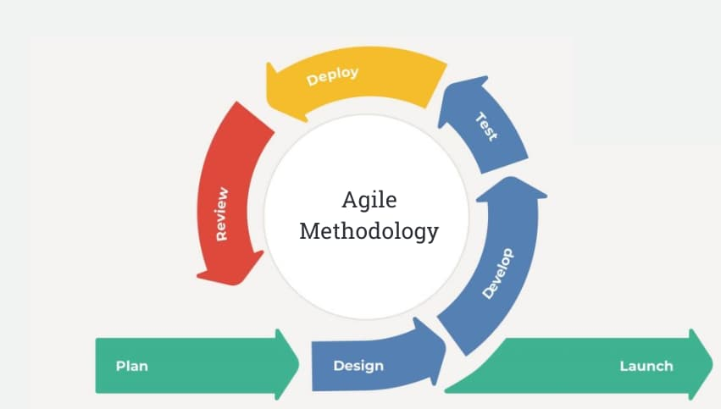
AGILE methodology
- Plan and assign roles early
- Have regular stand-up meetings
- Test often and early
- Have review sessions where you adapt and modify the plan as required
- Adapt the methodology to suit your group strengths and needs

Slide 24


Computational Thinking Project - Student Survey
This department project aims to develop AI tools to address some of the challenges you (the students) face as you learn computationally thinking materials such as coding.
We would love your feedback on what tools would be useful:
Survey part 1
Survey part 2
https://docs.google.com/forms/d/e/1FAIpQLSfjhG5pf4zUPEnZKG1tBEucKdDIWZM1-893fP9EgfAQaxQHdg/viewform?usp=sharing
https://docs.google.com/forms/d/e/1FAIpQLSe4mjm40hLk3gY0aTGAkOE8EsxtTs-bYPoFasXRIwk7q1jOCg/viewform?usp=sharing

Slide 25
Good luck! 💪

Slide 26
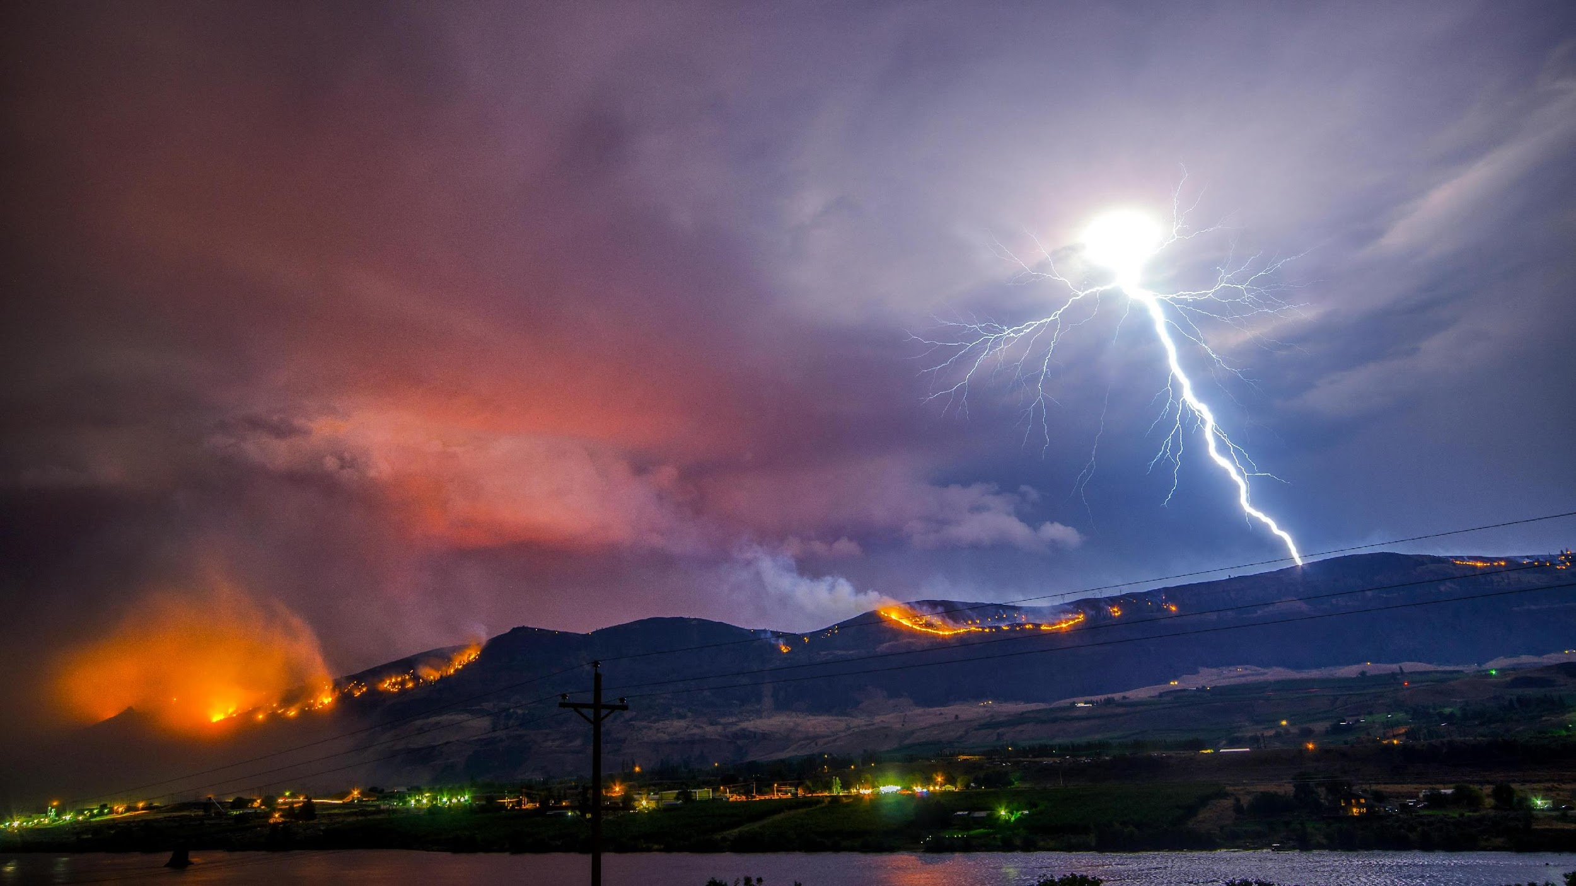
J
A
N
2
0
2
5
ACSE/EDSML MINI-PrOJECT
Predicting the unpredictable
Wenatchee, WA, United States, 2013 (Frank Cone)

Slide 27
Key metric: rollout error

